Slide 1
Methodological considerations for teaching languages to dyslexic students
Judit Kormos, Lancaster University
ENGaGE project Kick-off meeting 2017 Szeged Hungary

Slide 2
Dyslexia is like a 100 meter track race. In my lane I have hurdles but no one else does and it is unfair that I am the only one with hurdles. It’s hard. It’s like starting out, the gun shoots and then I take off and start running like my other classmates.Because we have all had the same education how to run, I hit the first hurdle and fall flat on my face. My parents and teachers are yelling at me at the sidelines, Try harder. The other kids are making it down the track. Okay, pulling myself up, I try running faster and fall even harder after hitting the next hurdle. Then someone takes the time to show me how to run hurdles. I can now catch up with my classmates. The key is that I have to do it differently, the way that works best for me.
Notes:
Dyslexia is like a 100 meter track race. In my lane I have hurdles but no one else does and it is unfair that I am the only one with hurdles. It’s hard. It’s like starting out, the gun shoots and then I take off and start running like my other classmates.Because we have all had the same education how to run, I hit the first hurdle and fall flat on my face. My parents and teachers are yelling at me at the sidelines, Try harder. The other kids are making it down the track. Okay, pulling myself up, I try running faster and fall even harder after hitting the next hurdle. Then someone takes the time to show me how to run hurdles. I can now catch up with my classmates. The key is that I have to do it differently, the way that works best for me.

Slide 3
RULADA

Slide 4
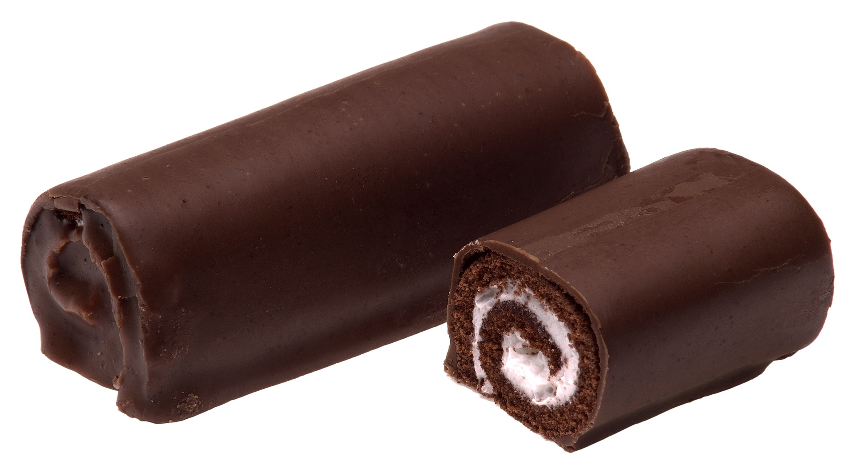
Six key elements of inclusive language teaching
Recognize
Learning strategies
Accommodate
Understand
Differentiate
Apply multisensory techniques
Notes:
There are six key elements of inclusion

Slide 5
What type of learning difficulties are there?
Specific learning difficulties
Dyslexia and reading comprehension problems
Dyscalculia (numeracy problems)
Attention Deficit and Hyperactivity Disorder
Dyspraxia (fine and gross motor co-ordination)
Dysgraphia (handwriting, spelling, writing)

Slide 6
Specific learning difficulties
Dyslexia
Dyscalculia
Dysgraphia
Dyspraxia
ADHD
Learning difficulties overlap.
Learning difficulties are placed on a continuum: there are no clear cut-off points.
Learning difficulties have different degrees of severity.

Slide 7
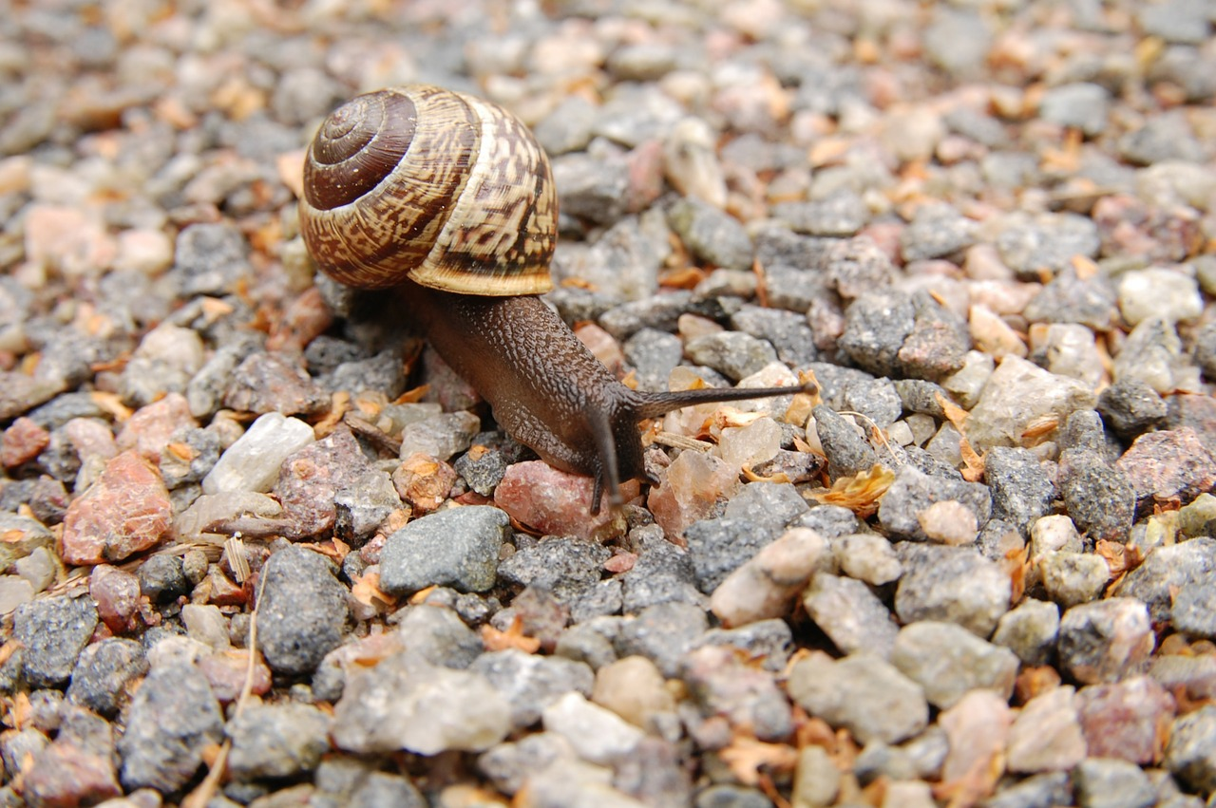
Causes of learning difficulties
SpLDs
Phonological processing problems
Short-term memory
Executive functions (attention)
Speed of processing

Slide 8
Link between first and second language difficulties
First language skills are foundations of L2 learning
Second language learning processes
SpLDs
L2 learning difficulties
Not every student with an SpLD will necessarily have difficulties in L2 learning.
Not everyone who is struggling to learn an L2 has an SpLD.

Slide 9
Reading difficulties in L2
Word-level reading
Difficulties pronouncing words while reading
Difficulties inferring meaning of unknown words
Text level reading
Difficulties understanding key and detailed information
Difficulty inferring implicit meaning
Slow pace
Inaccurate word recognition
Paying attention to meaning while reading aloud

Slide 10
Writing difficulties in L2
Word-level writing
Text level writing
Difficulties organizing ideas
Coherence
Slow pace
Inaccurate spelling
Accuracy
Proofreading and revision

Slide 11
Difficulties with L2 listening and speaking
Listening
Speaking
Pronouncing words
Distinguishing similar sounding words
Paying attention
Accuracy
Coherence of ideas
Remembering information
Understanding implied meaning

Slide 12
Difficulties with L2 vocabulary
Memorizing words
Using words
Difficulty retrieving words
Mixing up words
Learning form-meaning links
Learning other information related to words (e.g. spelling, pronunciation, grammatical information
Accuracy
Proofreading and revision

Slide 13
Key elements of inclusive language teaching
Notes:
There are six key elements of inclusion

Slide 14
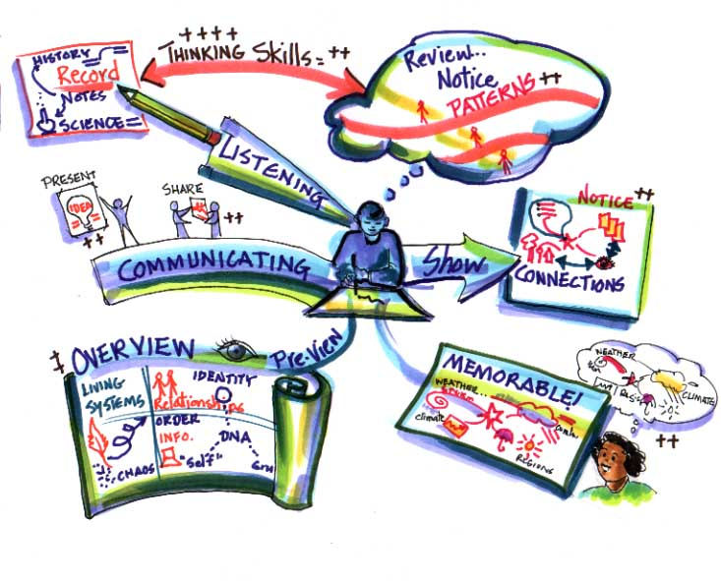
Learning strategies
Discuss time-management
Learning diary/schedule
Practice self-evaluation
Discuss ways about managing negative feelings and emotions
Practice use of text comprehension strategies
Practice test preparation and test taking strategies

Slide 15
Memory techniques
Mnemonics – Big Elephants Can Always Understand Small Elephants
Keyword method
Chunking
Rhyme
Mind-maps

Slide 16
What can we accommodate?
Classroom management
(groupwork, pairwork)
Presentation and access to material
(multiple channels, handouts)
Accommodations
Environment
(Light, temperature, seating arrangements)
Level of support
(teacher, peers)
Pacing
(slow down, revise, recycle)
Notes:
We can offer accommodations in many different ways. Please animate as in current slide
[1]
We can make adjustments in classroom management and use pair or group work instead of individual work to support students with learning difficulties.
[2]
Changes in the environment can include adjusting the light or temperature so that everyone feels comfortable. We can use a seating arrangement so that the student who needs our attention is close to us.
[3]
Another possibility is to slow down the pace of our teaching and cover less in a class and revise more frequently.
[4]
Instead of just giving instructions orally, we can write down the steps for the students, we can use more visuals, give handouts about the material covered and allow students to make recordings.
[5]
Finally we can offer more in and outside class support or set up a peer tutoring system.

Slide 17
Content
Differentiate
Process
Product
Environment

Slide 18
Differentiation within tasks
Students complete only odd-numbered questions or specifically selected items
Teacher provides responses to several items and the student completes the rest.
Divide a worksheet into sections and student does a specific section only
Notes:
The teacher can ask the student to complete only odd-numbered tasks, questions or specifically selected items
The teacher can provide responses to several items and ask the student to complete the rest.
The teacher can divide a worksheet into sections and instruct the student to do a specific section.

Slide 19
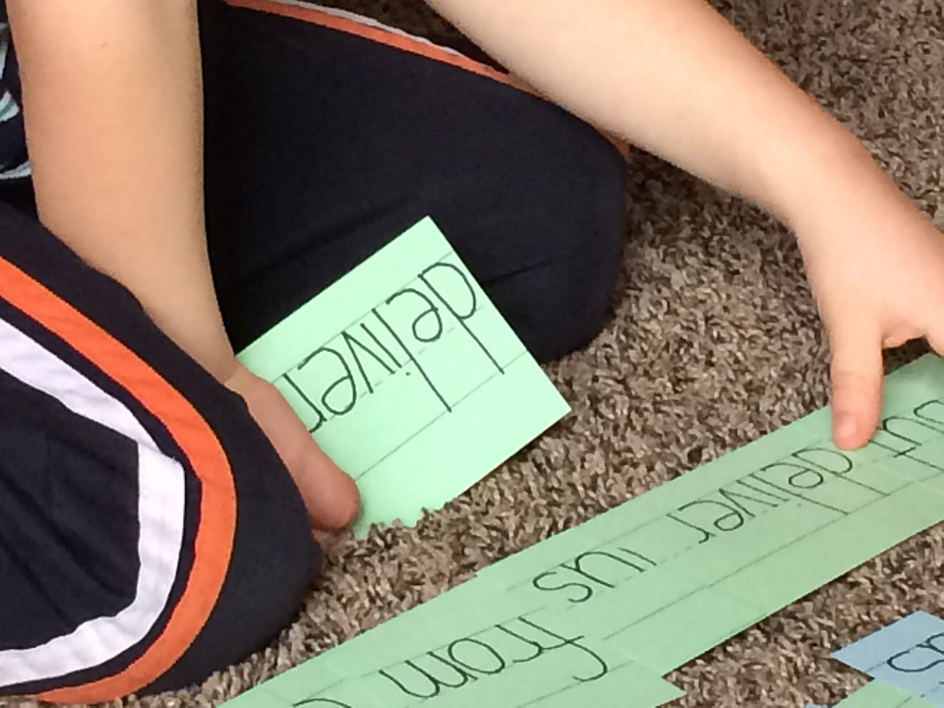
Differentiation across tasks or task types
Students listen to a text instead of/while reading it
Students underline, match, select possible answers rather than writing down the answer
Choice of presentation mode (e.g. spoken, written)

Slide 20
Multi-sensory teaching methods
Using multiple sensory channels

Slide 21
Components of multi-sensory teaching
Small, cumulative steps
Direct, explicit teaching
Highly structured (from simple to complex)
Frequent revision, practice
Notes:
[Add animation order as indicated]
[1]
Because students with learning difficulties find it challenging to deal with the complexities of another language at many levels, it is important to carefully structure the instruction and proceed from simple language structures to complex ones. This requires that language teachers think carefully about the sequence in which different elements and structures of language are presented in the syllabus.
[2]
We already mentioned that slowing down the pace of teaching and proceeding small cumulative steps also helps students to overcome the difficulties caused by short-term memory limitations.
[3]
Related to this, students with learning difficulties also need more frequent revision opportunities and more practice. Overlearning can sometimes be the key to success.
[4]
Students with learning difficulties also find it difficult to learn implicitly from the input they get. In other words, it is very challenging for them if they are expected to discover rules and regularities of the language without guidance. They benefit hugely from explicit explanation or from guided discovery activities where there is an opportunity to check that their assumptions about rules and regularities were correct.

Slide 22
More Information
www.dystefl.eu

