Slide 1
Common European Framework of Reference for Languages
A1 – A2
Poór Zsuzsánna
Lingua-Met KKT Veszprém

Slide 2
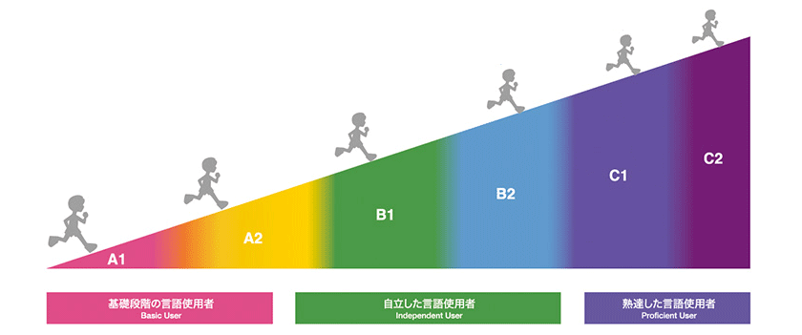
What is the CEFR?
a standard for describing language proficiency
a common basis for the elaboration of language syllabuses, curriculum guidelines, examinations and textbooks
a tool for positive lifelong learning

Slide 3
What is the CEFR?
https://www.youtube.com/watch?v=JwlVExKgEuQ

Slide 4
Level A1.1
Students at level A1.1
can understand and use familiar everyday vocabulary in simple situations;
can ask and answer simple questions about personal details;
can participate in ordinary interactions, provided the other person talks slowly and clearly.

Slide 5
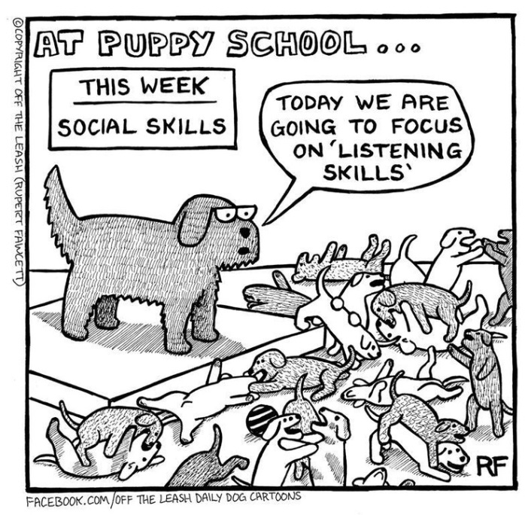
The skill in oral reception: listening
Students can
follow classroom language;
understand and follow simple instructions especially if they are illustrated with drawings;
understand very basic vocabulary and simple questions.

Slide 6
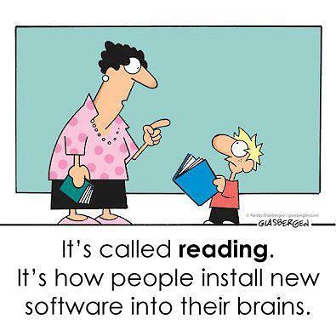
The skill in written reception: reading
Students can
recognise the most common words or expressions of everyday life;
understand simple illustrated instructions;
spot and understand very simple information in a short text;
understand short messages containing familiar vocabulary.

Slide 7
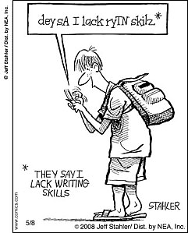
The skill in written production: writing
Students can
recognise and copy words or brief messages, write figures and dates;
fill in forms with personal details;
write very simple messages to friends.

Slide 8
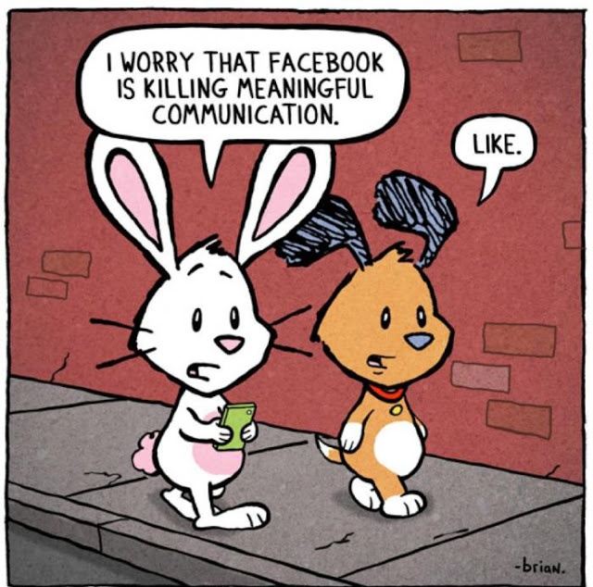
The skill in oral production / interaction: speaking
Students can
use simple phrases and sentences;
ask and answer simple questions within familiar topics;
communicate in a very simple way provided the other person speaks very slowly and repeats if they did not understand.

Slide 9
Level A1 (Breakthrough)
Students at level A1
have a basic vocabulary related to everyday situations;
show only limited control of simple grammatical structures and sentence patterns;
can ask and answer questions about personal details;
can interact in a simple way provided the other person talks slowly and clearly and is ready to help;
can establish basic social contact by using the simplest everyday polite forms of greetings, introductions, saying please, thank you, sorry, etc.

Slide 10
https://www.youtube.com/watch?v=qycqF1CWcXg

Slide 11
The skill in oral reception: listening
Students can
follow speech which is slow and carefully articulated, with long pauses to assimilate meaning;
understand instructions and follow short, simple directions;
recognise and understand familiar words and very basic phrases concerning everyday situations when people speak slowly and clearly.

Slide 12
The skill in written reception: reading
Students can
​recognise familiar vocabulary and simple sentences on notices and posters;
follow short, simple written instructions and directions;
spot and understand simple information in a short text;
understand short messages containing familiar vocabulary.

Slide 13
The skill in written production: writing
Students can
copy familiar words and set phrases used regularly;
fill in forms with personal details;
write short, simple messages;
write simple sentences about themselves and imaginary people.

Slide 14
The skill in oral production / interaction: speaking
Students can
use a basic vocabulary related to personal details;
use simple phrases and sentences in everyday situations and within familiar topics;
ask and answer simple questions in areas of immediate need or on very familiar topics;
interact in a simple way provided the other person is prepared to rephrase things at a slower rate of speech.

Slide 15
Level A2 (Waystage)
Students at level A2
use basic sentence patterns and simple structures correctly in everyday situations;
can describe their background, immediate environment and matters in areas of immediate need;
can communicate in situations requiring a direct exchange of information on familiar matters;
can handle short social exchanges, using everyday polite forms of greeting; can make and respond to invitations, suggestions, apologies, etc.

Slide 16
The skill in oral reception: listening
Students can
understand what is said clearly, slowly and directly to them in simple everyday conversation;
​understand simple directions relating to how to get to places on foot or by public transport;
catch the main point in short, clear, simple messages and announcements;
understand short, simple texts on familiar matters.

Slide 17
The skill in written reception: reading
Students can
understand everyday signs and notices in public places, and instructions, when expressed in simple language;
ﬁnd speciﬁc information in simple everyday material such as advertisements, menus and timetables;
understand short, simple texts describing events, containing the highest frequency vocabulary;
understand basic types of letters on familiar topics.

Slide 18
The skill in written production: writing
Students can
write a short text about their family, living conditions, educational background;
write about everyday aspects of their environment in linked sentences;
write very short, basic descriptions of events, past activities and personal experiences;
write short, simple imaginary biographies about people.

Slide 19
The skill in oral production / interaction: speaking
Students can
give a simple description of people, living conditions, likes/dislikes, possessions;
describe plans and arrangements, habits and routines, past events and personal experiences;
exchange ideas and information on familiar topics in predictable everyday situations , provided they are given some help to express what they want to;
use simple techniques to start, maintain, or end a short conversation.

Slide 20
Level A2+
Students at this level
understand enough to manage simple exchanges with reasonable ease, using relatively rich vocabulary;
make themselves understood and exchange ideas and information on familiar topics in predictable everyday situations, provided the other person helps if necessary;
can communicate successfully on basic themes if they can ask for help to express what they want to;
are more active in initiating, maintaining and closing simple, restricted face-to-face conversations.

Slide 21
"Communication is
the solvent of all problems, therefore communication skills are the foundation
for personal development.”
—Peter Shepherd

